Slide 1
Machine Learning

Slide 2
What Is Machine Learning?
Automating automation
Getting computers to program themselves
Writing software is the bottleneck
Let the data do the work instead!

Slide 3
Traditional Programming
Machine Learning
Data
Computer
Output
Program
Data
Computer
Program
Output

Slide 4
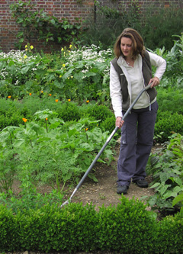
Magic?
No, more like gardening
Seeds = Algorithms
Nutrients = Data
Gardener = You
Plants = Programs

